Slide 1

SUGGESTME MUSIC
Web that knows your music taste..

Slide 2
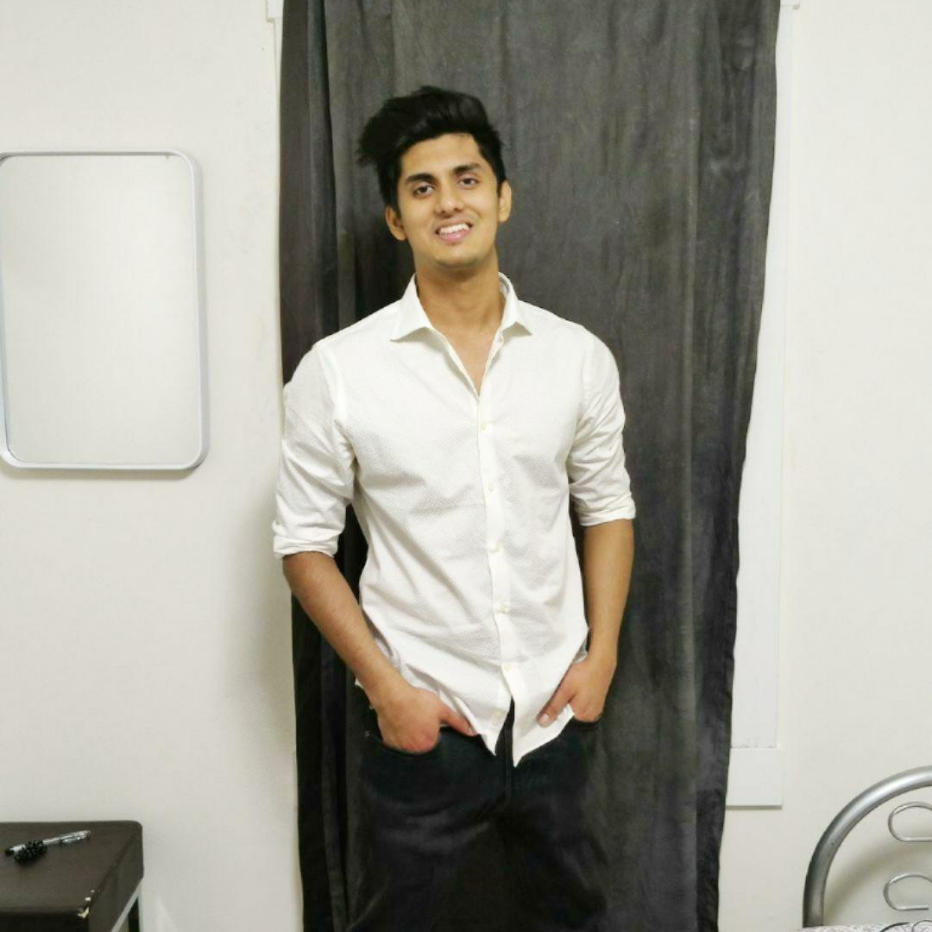
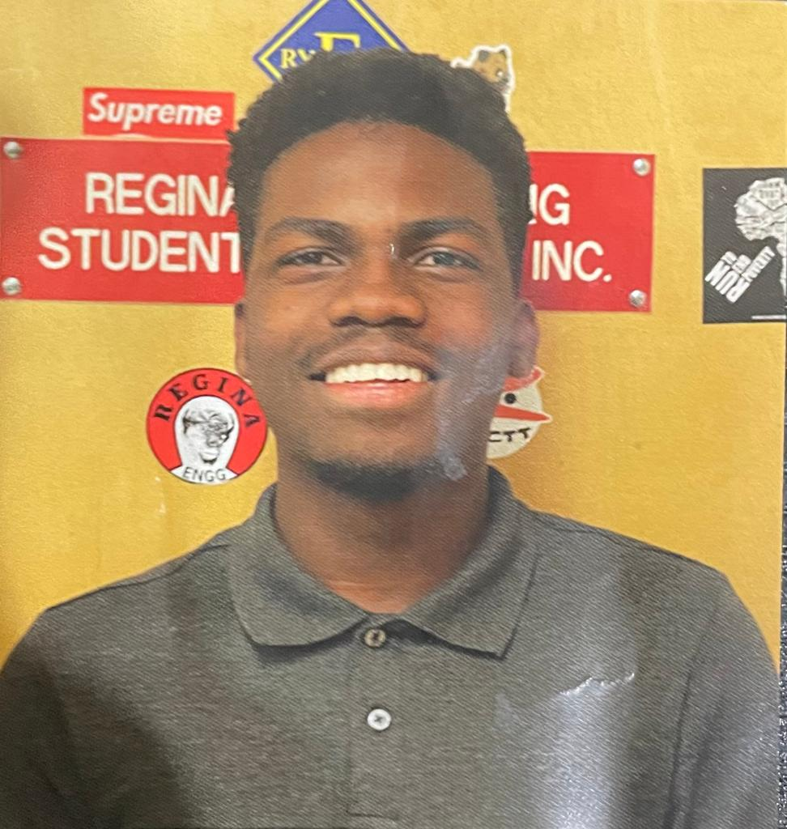

Team: Data
MEMBERS OF TEAM DATA
Swarnim Kumar
Abiola Keshiro
Amandip Padda
Quality assurance and documentation - To assure the quality and avoid any kind quality failure. i.e Quality management.
Frontend developer - Will create the website and design how the webpage looks like. The client-side view basically.
Back-end developer - Responsible for building and maintaining the back end of the website. The server side view

Slide 3

WHY
As a group, we wanted to find a better way of getting music recommendations in a more tailored way

Slide 4
WHAT
A website that gives users, artist recommendations based on other artists they have searched for, or liked on our website

Slide 5
HOW
We used React and other web designing tools, we also looked at different methods of implementing

Slide 6
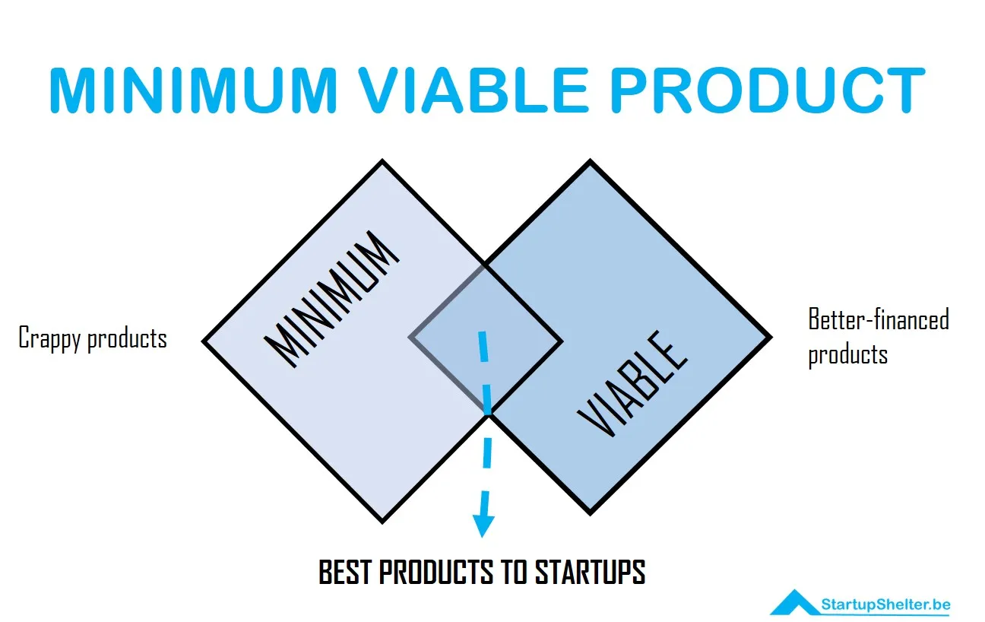
MVP ( Minimum Viable Product )
MVP 2
A fully functional website that gives user music recommendations based on their account liked history and searches. This will be a fully functional website that will store users' data.
MVP 1
A functional website that gives users, artist recommendations based on other artists they have searched for, or liked on our website

Slide 7

Document for our project Management

Slide 8
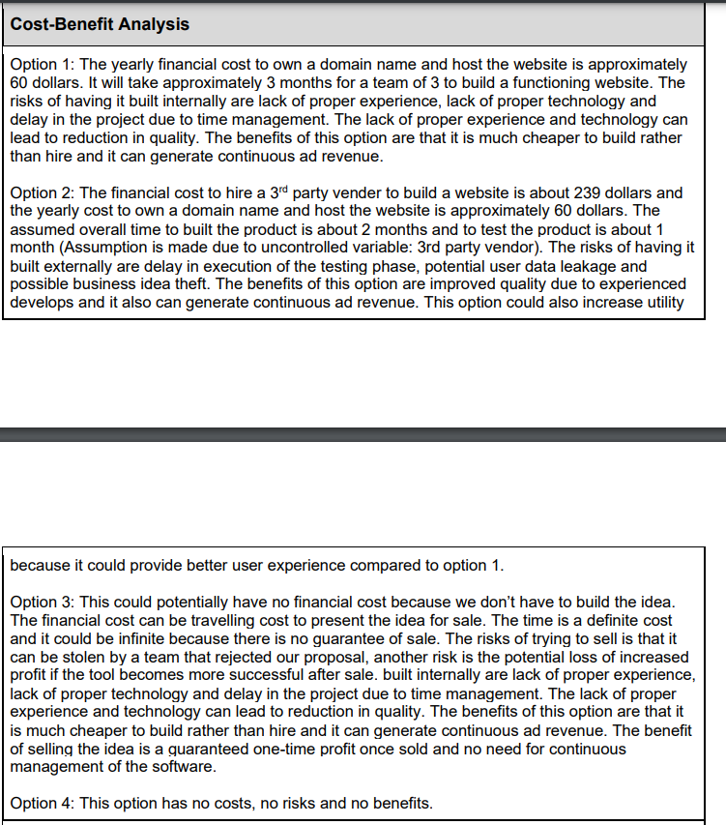
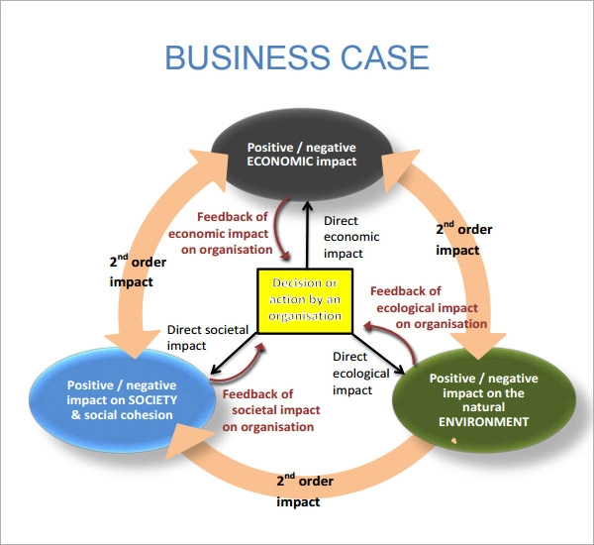
BUSINESS CASE DOCUMENT
This document was used to explore the business opportunity, options and cost/ benefit analysis

Slide 9
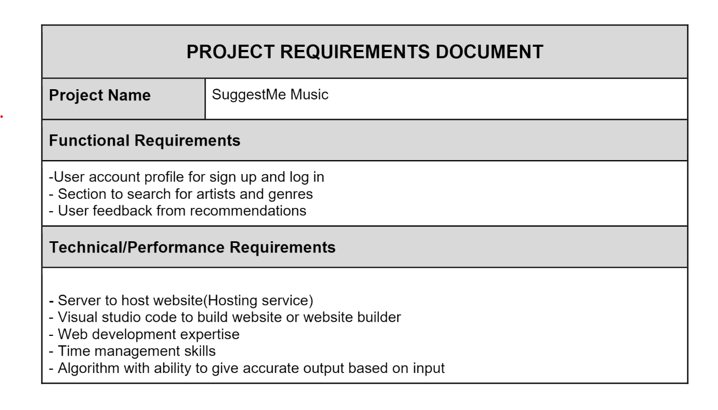
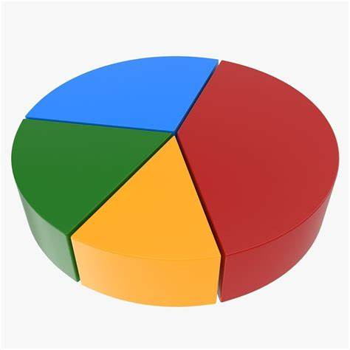
Project Requirements Document
This shows the functional and technical requirements of the solution

Slide 10
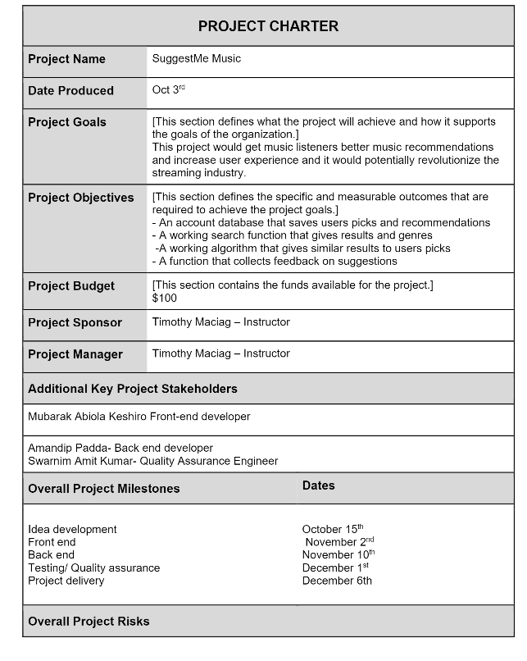

Project charter document
This document showcases the goals, objectives, milestones and risks involved in this project

Slide 11

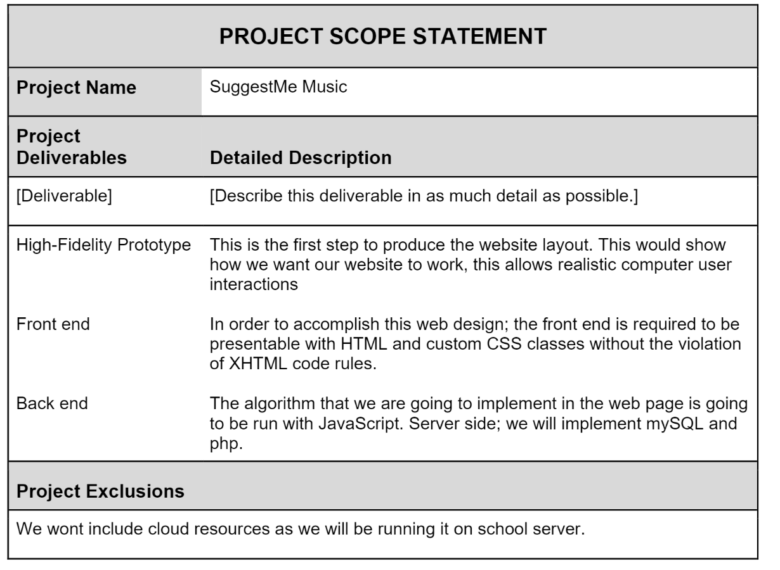
Project Scope Statement
This document explores all project deliverables and descriptions

Slide 12
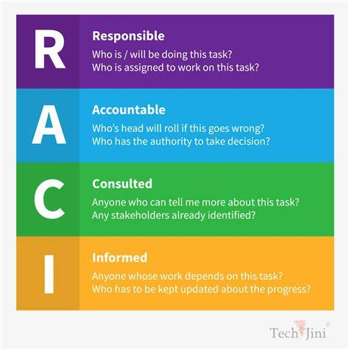
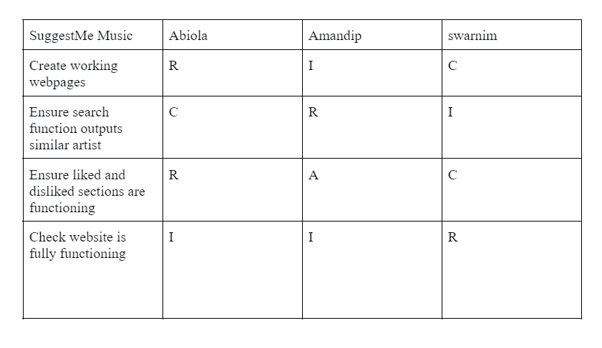
RACI CHART
This document explores the people involved in a project activity including people Responsible, Accountable, Consulted, or Informed for the corresponding task, milestone, or decision.

Slide 13
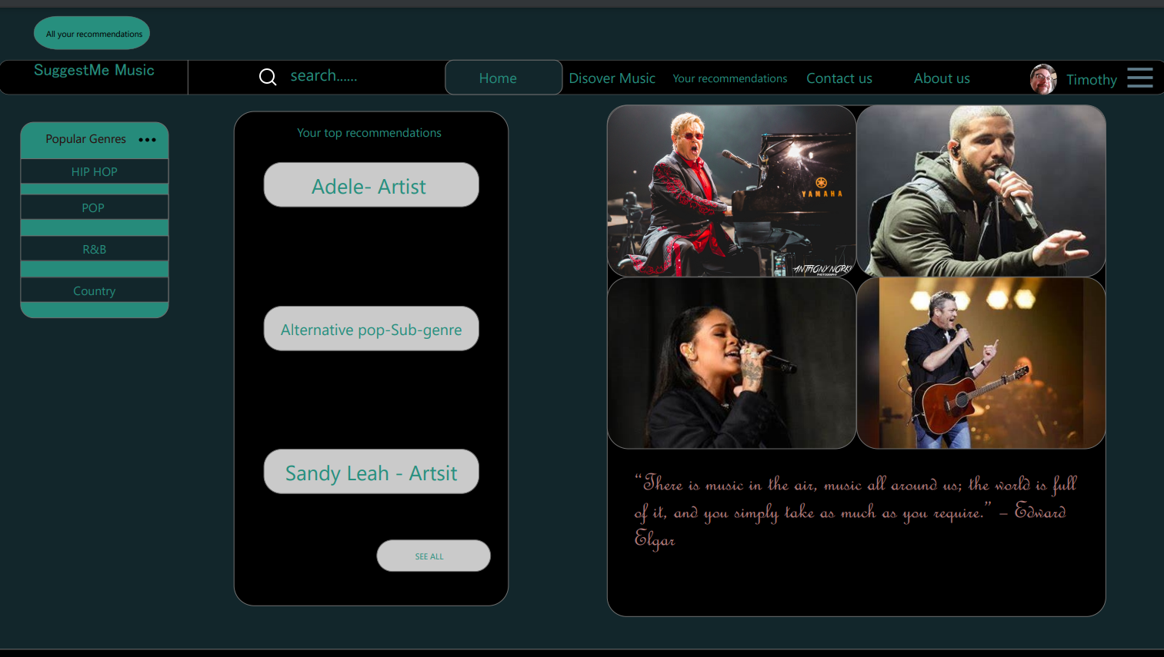

Slide 14
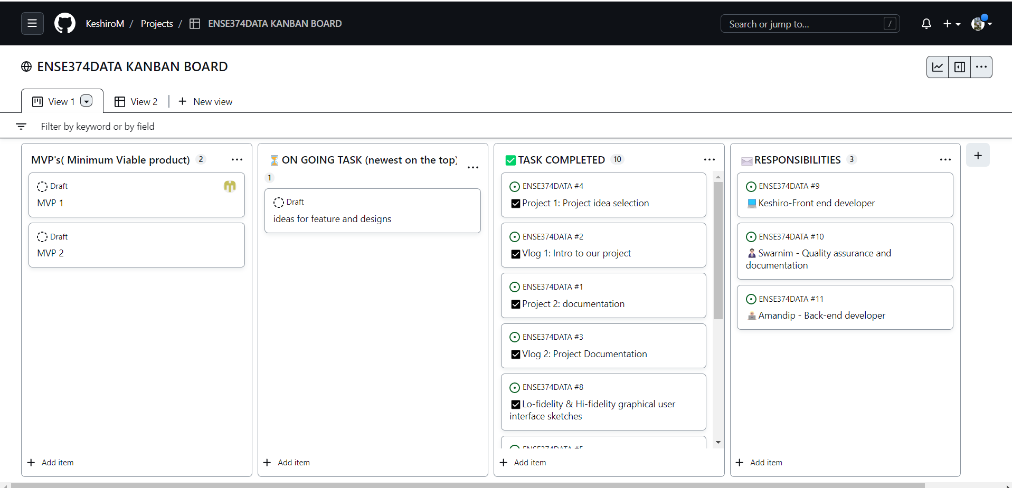
ENSE 374 DATA: KANBAN BOARD

Slide 15
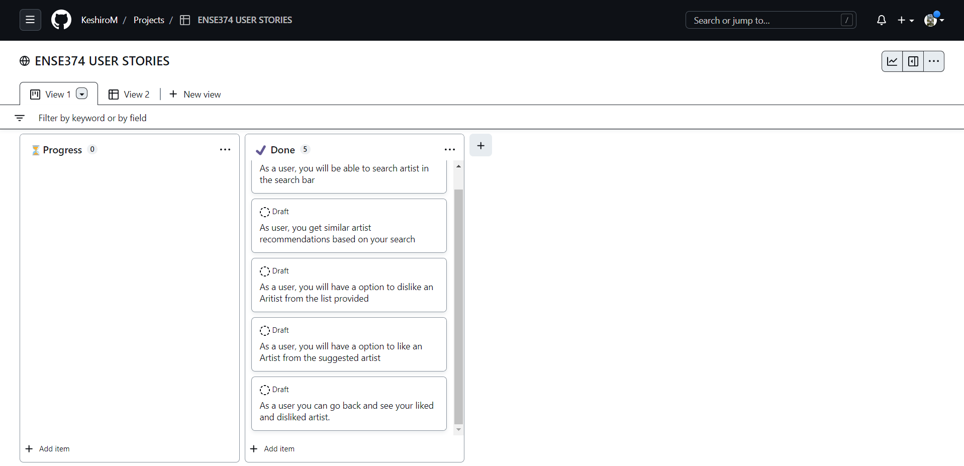
ENSE374 DATA USER STORIES

Slide 16

Feedbacks from the User….
Github presentation is confusing, multiple files with '- Copy.\*' and I'm unsure which is the one I am supposed to read
Ben (group team crusher)

